Slide 1

CST1302 Foundation of Web Programming – Lecture 6
A. A. Datti

Slide 2
Course Outline
Introduction to WWW
Structuring and Formatting with HTML
Basic Text
Lists
Hyperlinks
Multimedia
Tables
Forms
Styling with CSS

Slide 3
Overview of Forms
HTML Forms are one of the main points of interaction between a user and a web site or application. They allow users to send data to the web site.
An HTML Form is made of one or more controls. Those controls can be text fields (single line or multiline), select boxes, buttons, checkboxes, or radio buttons. Most of the time those controls are paired with a label that describes their purpose. (properly implemented labels are able to clearly instruct both sighted and blind users on what to enter into a form input).
The main difference between a HTML form and a regular HTML document is that, most of the time, the data collected by the form is sent to a web server.
In that case, you need to set up a web server to receive and process the data (To be covered in CSC2233).

Slide 4
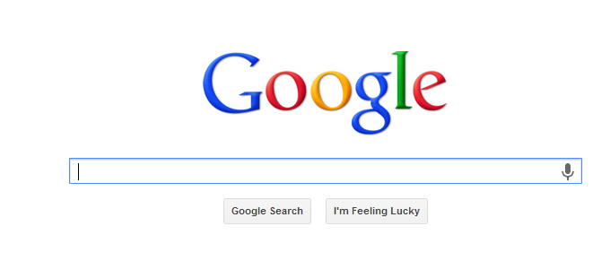
Overview of Forms
Consider Google’s search form:
The form is quite simple; it contains just three form controls: the text box that accepts the keywords used in the search, the search button that submits the form and another button that directly opens one of the search results.

Slide 5
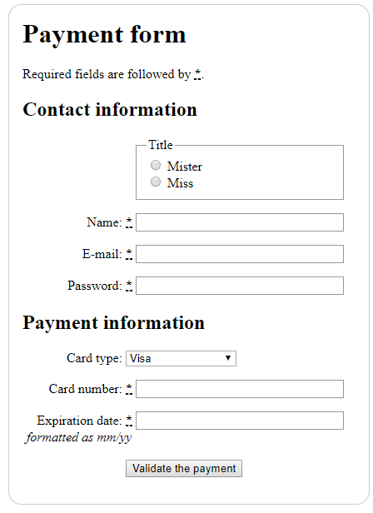
Examples

Slide 6
HTML form
<form> tag specifies the beginning of a form area. The closing </form> tag specifies the end of a form area. There can be multiple forms on a web page, but they cannot be nested inside one another.
<form>
. . . form controls go here . . .
</form>
The form element can be configured with attributes that specify which server-side program or file will process the form, how the form information will be sent to the server, and the name of the form. Example
<form name="order" method="post" id="order" action="demo.php">
. . . form controls go here . . .
</form>

Slide 7
HTML form element ATTRIBUTES
The form element attributes:
name -Identifies the form
method
get – it causes the form data to be appended to the URL and sent to the web server
post – The post method is more private and transmits the form data in the body of the HTTP response.
id -provides a unique identifier.
action
Specifies the server-side program or script that will process your form data. i.e. where to send the data
target
Specifies where to display the response that is received after submitting the form (current tab/window, new window etc).
autocomplete
Specifies if the browser should autocomplete the form (default: on).

Slide 8
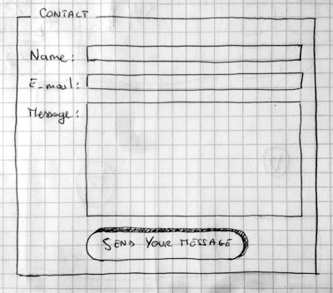
My First Form

Slide 9
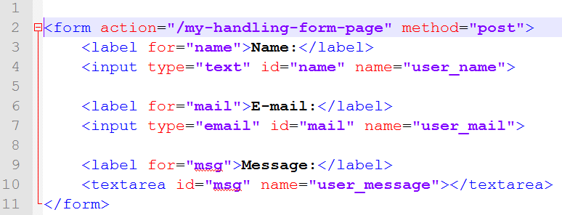
My First Form
To build our contact form, we will use the following HTML elements:
<form>, <label>, <input>, <textarea>, and <button>.

Slide 10
Form Elements
Form controls are the objects that accept user information. Types of form controls include text boxes, text area, select lists, radio buttons, check boxes, and buttons.
<input> Element
This element inserts a control for one line input from the user.
Its the most important form element is the <input> element.
The <input> element can be displayed in several ways, depending on the type attribute.

Slide 11
Simple Text and Password
Text
defines a one-line text input field
Password
a text field which masks the entered text with * signs
First name:<br>
<input type="text" name="FirstName“ value=“Buhari">
User name:<br> <input type="text" name="username"><br> User password:<br> <input type="password" name="psw">

Slide 12
Label
<label> Element
Form labels are used to associate an explanatory text to a form field using the field's ID.
Clicking on a label focuses its associated field
The for attribute of the <label> tag should be equal to the id attribute of the related element to bind them together.
<label for="fn">First Name</label>
<input type="text" id="fn">
<label for="male">Male</label> <input type="radio" name="gender" id="male" value="male"><br>
<label for="female">Female</label> <input type="radio" name="gender" id="female" value="female"><br>

Slide 13
TextArea
<textarea> Element
The <textarea> element defines a multi line input field (a text area):
The rows attribute specifies the visible number of lines in a text area.
The cols attribute specifies the visible width of a text area.
<textarea name="message" rows="10" cols="30"> The students are attending Web programming lecture</textarea>

Slide 14
Dropdown List
<select> Element
The <select> element defines a (drop down) list:
The <option> elements defines an option that can be selected.
By default, the first item in the drop-down list is selected.
To define a pre-selected option, add the selected attribute to the option.
multiple attribute is used to select multiple options.
Size attribute defines the no. of visible options in the list.
<optgroup label=“ ”> element is used to define a group of related options in a drop-down list.
<select name="countries"> <option value=“USA">USA</option> <option value=“India”selected>India</option> <option value=“uk">UK</option> <option value=“australia">Australia</option>
<option value=“canada">Canada</option> </select>

Slide 15
Radio Button
Radio
Radio buttons let a user select ONLY ONE of a limited number of choices:
To define a pre-defined selection use the checked attribute
<input type="radio" name="gender" value="male" checked> Male<br> <input type="radio" name="gender" value="female"> Female<br> <input type="radio" name="gender" value="other"> Other

Slide 16
Checkbox
Checkbox
Checkboxes let a user select ZERO or MORE options of a limited number of choices.
<input type="checkbox" name="vehicle1" value="Bike"> I have a bike<br> <input type="checkbox" name="vehicle2" value="Car"> I have a car

Slide 17
Submit and Reset Buttons
Submit
defines a button for submitting form data to a form-handler.
The form-handler is typically a server page with a script for processing input data.
The form-handler is specified in the form's action attribute
Reset
defines a reset button that will reset all form values to their default values
Button
defines a generic button, used for javascript.
<input type="submit" name="submitBtn" value="Apply Now">
<input type="reset">
<input type="button" onclick="alert('Hello World!')" value="Click Me!">

Slide 18
Datalist
<datalist> Element
The <datalist> element specifies a list of pre-defined options for an <input> element.
Users will see a drop-down list of the pre-defined options as they input data.
The list attribute of the <input> element, must refer to the id attribute of the <datalist> element.
<input list="browsers"> <datalist id="browsers"> <option value="Internet Explorer"> <option value="Firefox"> <option value="Chrome"> <option value="Opera"> <option value="Safari"> </datalist>

Slide 19
Fieldsets
Fieldsets are used to enclose a group of related form fields:
The <legend> is the fieldset's title.
<form method="post" action="form.php">
<fieldset>
<legend>Client Details</legend>
<input type="text" id="Name">
<input type="text" id="Phone">
</fieldset>
<fieldset>
<legend>Order Details</legend>
<input type="text" id="Quantity">
<textarea cols="40" rows="10" id="Remarks"></textarea>
</fieldset>
</form>

Slide 20
Number and Color
Number
defines a numeric input field. You can also set restrictions on what numbers are accepted.
Color
is used for input fields that should contain a color. Depending on browser support, a color picker can show up in the input field.
AGE (between 16 and 35): <input type="number" name="quantity" min="16" max=“55">
Select your favorite color: <input type="color" name="favcolor">

Slide 21
Date
Date
is used for input fields that should contain a date. Depending on browser support, a date picker can show up in the input field.
You can also add restrictions to dates.
Birthday: <input type="date" name="bday">
Enter a date before 1980-01-01: <input type="date" name="bday" max="1979-12-31"><br> Enter a date after 2000-01-01: <input type="date" name="bday" min="2000-01-02"><br>

Slide 22
Month and Week
Month
allows the user to select a month and year.
Week
allows the user to select a week and year.
Birthday (month and year): <input type="month" name="bdaymonth">
Select a week: <input type="week" name="week_year">

Slide 23
Time and Datetime-local
Time
allows the user to select a time.
Datetime-local
specifies a date and time input field, with no time zone.
Select your time: <input type="time" name="usr_time">
Birthday (date and time): <input type="datetime-local" name="bdaytime">

Slide 24
Range and Email
Range
is used for input fields that should contain a value within a range.
Email
is used for input fields that should contain an e-mail address.
Depending on browser support, the e-mail address can be automatically validated when submitted.
Some smartphones recognize the email type, and adds ".com” and “@” to the keyboard to match email input.
<input type="range" name="points" min="0" max="10">
E-mail:<input type="email" name="email">

Slide 25
Search and URL
Search
is used for search fields (a search field behaves like a regular text field).
Url
is used for input fields that should contain a URL address.
Depending on browser support, the url field can be automatically validated when submitted.
Some smartphones recognize the url type, and adds ".com" to the keyboard to match url input.
Search Google: <input type="search" name="googlesearch">
Add your homepage: <input type="url" name="homepage">

Slide 26
File
File
a field used for uploading file
To upload more than one file use the multiple attribute
<input type="file" name="photo">

Slide 27
Attributes
Accept
The accept attribute specifies the types of files that the server accepts for file uploads.
It can only be used with <input type=“file”>
Audio/* - accepts all sound files
Video/* - accepts all video files
Image/* - accepts all image files
File_extension – File extension starting with the STOP character e.g .gif, .jpg, .doc, .pdf etc
To specify more than one value, separate with a comma( e.g accept=“image/jpeg, audio/*, video/*”)
<input type=“file" name="pic” accept=“image/*”>

Slide 28
Input Attributes
Value
The value attribute specifies the initial value for an input field.
The value attribute is used differently for different input types:
For "button", "reset", and "submit" - it defines the text on the button
For "text", "password", and "hidden" - it defines the initial (default) value of the input field
For "checkbox", "radio", "image" - it defines the value associated with the input (this is also the value that is sent on submit)
Note: The value attribute cannot be used with <input type="file">.
First name:<br> <input type="text" name="firstname" value=“Suhail">

Slide 29
….
Readonly
The readonly attribute specifies that the input field is read only (cannot be changed).
Disabled
The disabled attribute specifies that the input field is disabled.
A disabled input field is unusable and un-clickable, and its value will not be sent when submitting the form.
First name:<br> <input type="text" name="firstname" value=“Iliya" readonly>
First name:<br> <input type="text" name="firstname" value=“Shehu" disabled>

Slide 30
….
Size
The size attribute specifies the visual size (in characters) for the input field.
maxlength
The maxlength attribute specifies the maximum allowed length for the input field
First name:<br> <input type="text" name="firstname" value=“Madueke" size=“40”>
First name:<br> <input type="text" name="firstname" value=“Diezani" maxlength=“10”>

Slide 31
….
Autocomplete: on or off
When autocomplete is on, the browser automatically complete the input values based on values that the user has entered before.
Formtarget, formaction
Used with <input type=“submit”> to override the target and action attributes in the <form> element

Slide 32
….
Height and width
The height and width attributes specify the height and width of an <input type="image"> element to serve as a submit button.
autofocus
The autofocus attribute specifies that the input field should automatically get focus when the page loads.
<input type="image" src="img_submit.gif" alt="Submit" width="48" height="48">

Slide 33
….
pattern
The pattern attribute specifies a regular expression that the <input> element's value is checked against.
For example the input field that can contain only three letters (no numbers or special characters).
Country code:
<input type="text" name="country_code" pattern="[A-Za-z]{3}" title="Three letter country code">

Slide 34
….
placeholder
The placeholder attribute specifies a hint that describes the expected value of an input field (a sample value or a short description of the format).
The hint is displayed in the input field before the user enters a value.
<input type="text" name="fname" placeholder="First name">

Slide 35
….
required
The required attribute specifies that an input field must be filled out before submitting the form.
Step
The step attribute specifies the legal number intervals for an <input> element.
The step attribute works with the following input types: number, range, date, datetime, datetime-local, month, time and week.
Username: <input type="text" name="usrname" required>
<input type="number" name="points" step="3">

Slide 36
HTML Forms – Design Tips
Before starting to code, it's always better to step back and take the time to think about your form.
Designing a quick mockup will help you to define the right set of data you want to ask your user.
From a user experience point of view, it's important to remember that the bigger your form, the more you risk losing users.
Keep it simple and stay focused: ask only for what you absolutely need. Designing forms is an important step when you are building a site or application.

